Slide 1
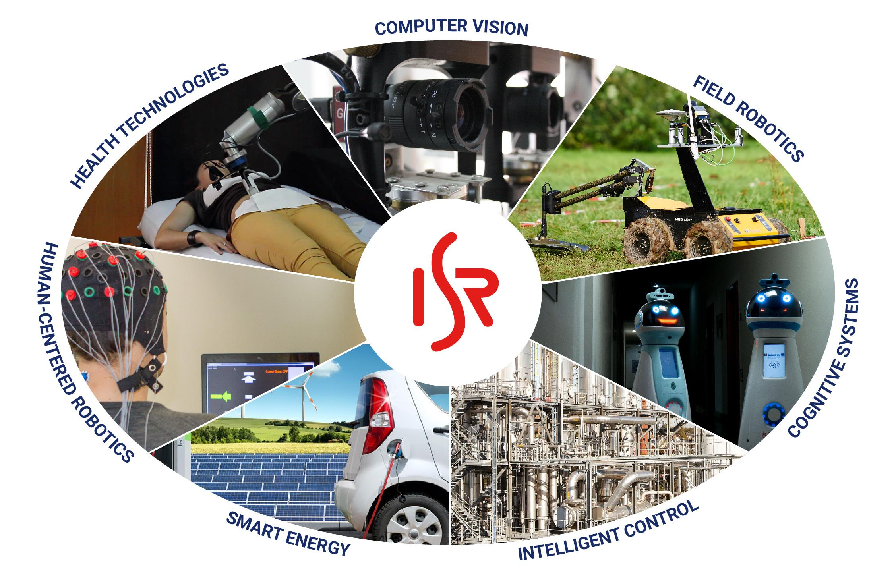
Open Research Day @ISR-UC
Presentation
subtitle
Place | date
Coimbra, 2024
ISR-UC

Slide 2
Open Research Day @ISR-UC
Title
Topic 1
Topic 2
Topic N
Coimbra, 2024
ISR-UC

Slide 3
Section Separator Slide (optional)

